Slide 1
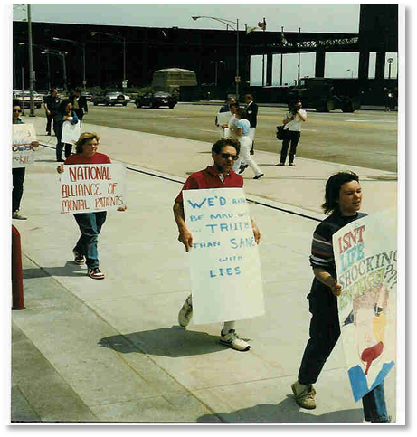
The History of the Consumer/Survivor Movement
Gayle Bluebird
Peer Services Consultant
“We’d Rather be Mad with the Truth, than Sane with Lies”
Protest March 1970’s

Slide 2
The Beginnings
Began in the 1970’s
Was similar to other civil rights movements
Started with small informal groups of ex-patients.
Followed de-institutionalization from the late 60’s.

Slide 3
Ex-Patients share similar stories of abuse:
Involuntarily committed
Were given shock treatment
Secluded and restrained
Being used as forced labor
Witnessing patients dying with no investigations.

Slide 4
Madness Network News
National Newsletter published in San Francisco.
Circulated from 1974-1986.
Outlet for political organizing.
Means of connecting ex-patients nationally.
Included poetry and artwork.
Drowning, by Tanya Tempkin

Slide 5
1976 Cover
Photograph of a 30-Day “sleep-in” protest in then-Governor Jerry Brown’s Office to protest deaths and abuses in State hospitals in California.

Slide 6
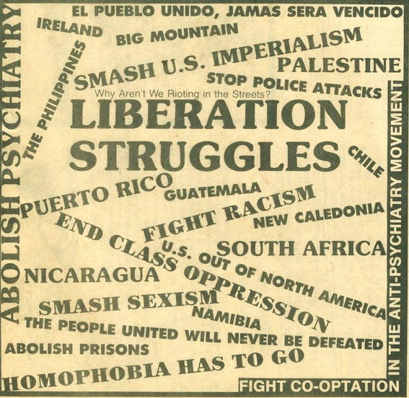
Goals of the Movement:
Liberation from Mental Health System.
Developing their own self-help programs.
Refusing to accept the label of “mental illness.”
To overcome the prediction they would never recover.

Slide 7
Groups with Different Names:
Insane Liberation Front (Portland, OR)
Liberation Project (New York City, NY)
Network Against Psychiatric Assault (San Francisco, CA)
Mental Patients Liberation Front (Boston, MA)

Slide 8
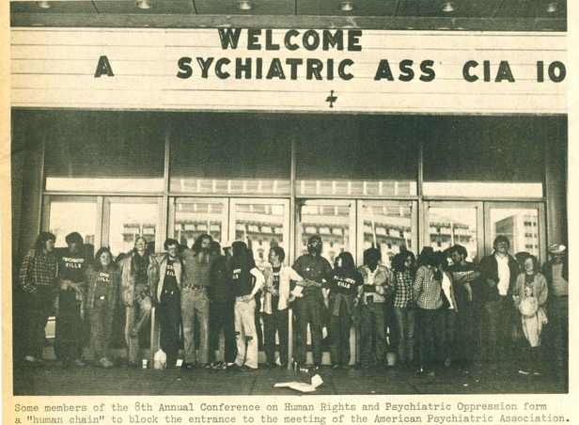
Annual Conference-Human Rights Against Psychiatric Oppression
First Conference in Detroit-1972
Held on campgrounds, colleges, campuses
Were organized with little to no money
People came by hitchhiking, buses, packed in cars.

Slide 9
Howie the Harp 1953-1995
“Crazy folk” (as he called us) are the most talented people in the galaxy. “Instead of diagnosing, locking up, and treating us, the world should recognize our true worth and support our talents, creativity, and sensitivity.” Howie carried a harmonica with him everywhere, to make music, mediate conflict and create peace.

Slide 10
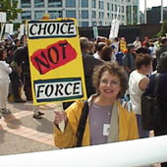
Judi Chamberlin
1978- Published book On Our Own: Patient Controlled Alternatives to the Mental Health System.
Considered by some to be the “Mother of the Consumer/ Survivor Movement.”

Slide 11
The 1980’s Transitioning Time
1985- On Our Own of MD first funded drop in center with State Funds.
1988- SAMHSA funded 13 Demonstration Drop in Centers.
1985- First Alternatives Conference, Baltimore MD.
1986- Congress passed the Protection and Advocacy for Individuals with Mental Illness (PAIMI) Act.
1986- Sally Zinman, Howie the Harp and Su and Dennis Budd wrote first manual with funds from the Federal Government “Reaching Across.”

Slide 12
Well-Being Project- California, 1987 Jean Campbell
Research by and for mental health clients
500 persons interviewed
61 percent of clients stated creativity essential to their well-being
24 percent stated they lacked creativity in their lives
Art by Jean Campbell

Slide 13
The 1990’s
Holistic Healing
Arts Guidebook Published- “Reaching Across with the Arts”
Self-Determination and Self-Sufficiency
Adverse Childhood Experiences (ACE) study
Confronting Stigma and Discrimination
Arts and Peer Support
National Mental Health Consumers’ Self-Help Clearinghouse established in Philadelphia-Joseph Rogers
Offices of Consumer Affairs- First in Alabama- Joel Slack.

Slide 14
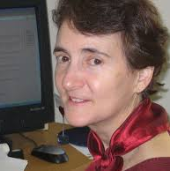
National Mental Health Consumers’ Self-Help Clearinghouse (in Pennsylvania)
Joseph Rogers
Susan Rogers
The First SAMHSA-funded Consumer National Technical Assistance Center

Slide 15
Paolo del Vecchio
First Consumer Affairs Director, Center for Mental Health Services/SAMHSA

Slide 16
David Oaks
Mind Freedom International

Slide 17
Dan Fisher, M.D. Ph.D.
Executive Director, National Empowerment Center

Slide 18
2000’s- Forward Special Projects and Partnerships
Peer Specialist Certification
Wellness Coaches
Recovery Domains
Peers in many different venues
Crisis Alternatives
Arts programs

Slide 19
Mary Ellen Copeland
WRAP, Wellness Recovery Action Plan.

Slide 20
Reaching Across with The Arts
A self-help arts guide published in 2000 with funds from CMHS with information that is still relevant and helpful to mental health consumers today
www.alteredstatesofthearts.com

Slide 21
The Cemetery Project Milledgeville, GA
Cemetery restored with beauty to honor 25,000 people who had been buried in unmarked graves at Central State Hospital since 1842. This project, coordinated by Larry Fricks and Pat Deegan, has spread across the U.S. and many others like it now exist at other hospital cemeteries, including the cemetery at St. Elizabeth’s Hospital in Washington, DC.

Slide 22
Sally Zinman
Sally Zinman, Pat Deegan, Jacki McKinney, Gayle Bluebird
2013 NYAPRS Conference, Catskills, NY
Honored as “Lifetime Achievers of the Consumer/Survivor Movement”

Slide 23
Our Future Happening NOW:
More people with Jobs
People living independently
Specialized Positions for Peer Supporters
Peer Support Respite Centers
Peer Run Art Centers
Online Training for peer specialists

Slide 24
Tell Us About Your Innovative Programs:
Start Here

Slide 25
Presentation By:
Gayle Bluebird
“Henrietta”
Gaylebluebird1943@gmail.com
352-282-2924
Contact her for consulting or keynotes

